Slide 1
Revision Record
Don’t Print This Page
Course Code
Product
Product Version
Course Version Issue
Domain
Huawei CTI
ICDV300R005C45
eSpace CC ISV V100R001C01LINH04
Developer / Modifier
Date
Approver
New / Update
< Name of Author >
< YYYYMMDD >
< Name of Approver >
New

Slide 2
CTI Installation and Upgradation

Slide 3

Agenda
Huawei IPCC Network Architecture Introduction
CTI Platform Overview and Installation
Web Application Server (WAS) Overview & Installation
CTI Upgradation
References

Slide 4
Objectives
Upon completion of this course, you will be able to:
Understand the CTI components and their terminologies
Install the CTI Platform & Upgrade on Windows OS.
Install the WAS on Windows OS.

Slide 5

Target Audience
This course has been designed for the audience who are undergoing training on Huawei IPCC solution. This course will make familiar the audience on the installation of the CTI platform and basic configuration of some of its components.

Slide 6
Training Pre Requisites
Undergone training on Huawei IPCC Solution Introduction
Undergone training on Basic Understanding of CTI Platform
and its components.
Basic Knowledge of UAP
Web Application Server Overview

Slide 7
Installation Pre Requisites
IP Address Planning
Network Planning
Operating system planning and availability
Hardware Planning
Apply for Licenses
Database Version and Planning
Notes:
Oracle DB Versions :
􀁺 Oracle9.2.0.8
􀁺 Oracle10.1.0.3
􀁺 Oracle11.1.0.7
SQL Server :
SQL Server2000 8.00.760
􀁺 SQL Server2005
􀁺 SQL Server2008

Slide 8
Agenda
Huawei IPCC Network Architecture Introduction
CTI Platform Overview and Installation
Web Application Server (WAS) Overview & Installation
CTI Upgradation
References

Slide 9

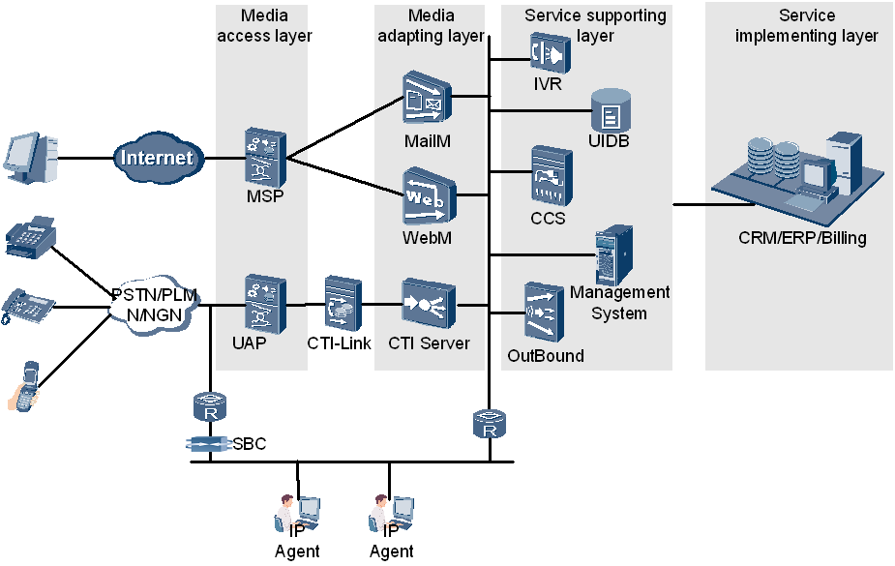
Huawei IPCC Network Architecture
Notes:
MSP: The media sender platform (MSP) is a system that processes, sends, and receives multimedia messages. The multimedia messages include MMS,SMs, WAP Push messages,Faxes, Emails.
UAP: The UAP provides the functions of the special narrowband resources required by the public switched telephony network (PSTN) or public land mobile network (PLMN), in addition to the functions of the broadband media resources required by the next generation network (NGN) or third generation (3G)
Media Access Layer
This layer supports the access of multiple media, such as voice, fax, VoIP, Web and email
Media Adapting Layer
This layer is used to process the accessed calls of various media. It processes calls of various media such as speech calls, E-mail calls and Web calls to unified calls so that various media can
communicate with the service supporting layer no matter what types the media are.
Service Supporting Layer
This layer is used to resolve, create and control the services. It is correlated with the media access
layer and provides component resources for realizing specific services. The equipment or
modules related to specific services can be constructed through flexible selection and
combination of the component resources.
Service Implementing Layer
This layer of the IPCC can perform both the automatic and manual services.

Slide 10
Agenda
Huawei IPCC Network Architecture Introduction
CTI Platform Overview and Installation
Web Application Server (WAS) Overview & Installation
CTI Upgradation
References

Slide 11
CTI Platform Overview
CTI (Computer Telephony Integration) platform is the technology that allows interaction with telephony and computer data networks.
CTI has various modules handling different types of calls such as voice, video, email, web etc.,
We will focus on installing the CTI platform in Windows environment. During installation of the CTI Platform we come across different CTI components like
MDS: Stands for Monitor Daemon Server which manages all the CTI Platform components. In case any server goes down, MDS restarts the server.
CTI-Link: Connection/Interface between CTI and UAP.
CCS: Stands for Core Control Server
ICDComm: Stands for Intelligent Call Distributor Communication. This is the protocol used for interaction between the CTI components.
MCP: Stands for Management Connection Proxy
WAS: Stands for Web Application Server for configuration of CTI.

Slide 12
CTI Platform OS Support
Huawei CTI Platform installation supports the following operation system
Windows OS (Windows XP SP2, Windows 2000 Server, Windows 2003 server, Windows 2008 R2(64-bit))
Linux OS ( Suse Linux9, Suse Linux 10)
HP-UX
IBM-AIX

Slide 13

Installing CTI Platform in WINDOWS
Download the CTI platform software for windows from the Huawei support site and store in the local system.
Path on support site:
Software Center => Version Software => Application and Software Product Line => Service and Software Public(19939) => CTI(360) => ICD(298) => ICD V300R005(163) => ICD V300R005C45(8)
File names:
ICDV300R005C45_WIN_ICD.zip
ICDV300R005C45_WAS_ICD.zip
ICDV300R005C45_PUBLIC_ICD.zip
Extract the ICDV300R005C45_WIN_ICD.zip, and run the
setup.exe to start installing the CTI platform

Slide 14
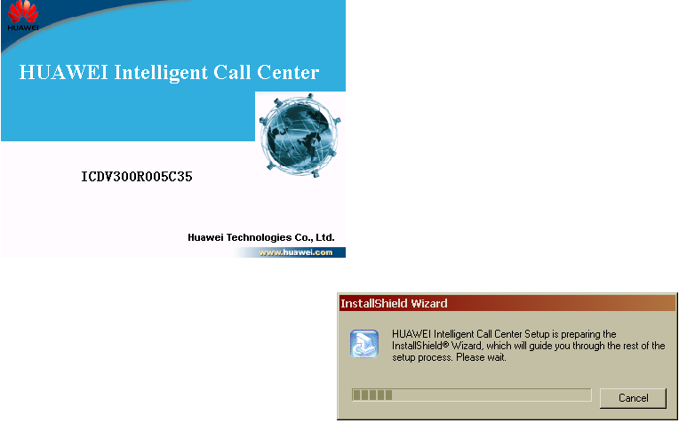
Installing CTI Platform in WINDOWS Contd.,
Step 1: Run Setup.exe

Slide 15
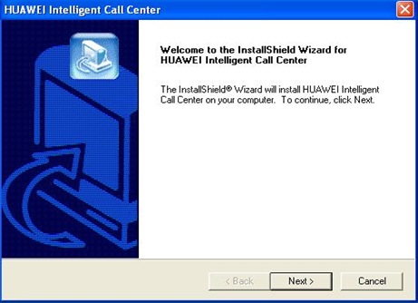
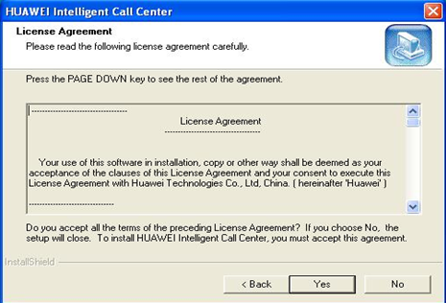
Installing CTI Platform in WINDOWS Contd.,
Step 2: Select Next
Step 3: Select Yes to accept the License Agreement

Slide 16
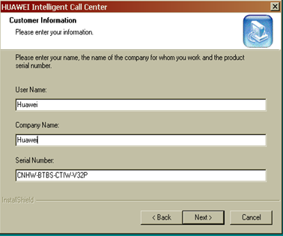
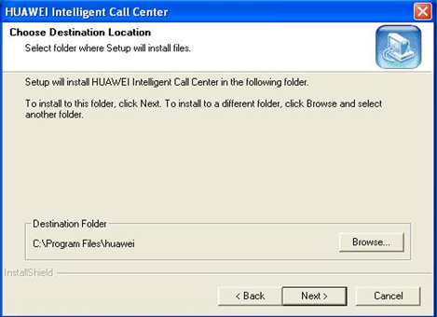
Installing CTI Platform in WINDOWS Contd.,
Step 4: Select Next
Step 5: Browse the Path to install and Select Next

Slide 17
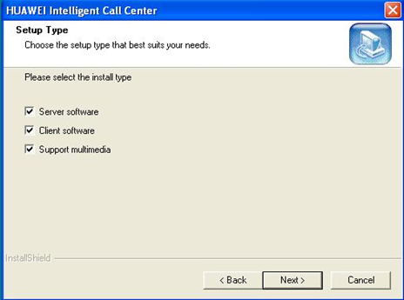
Installing CTI Platform in WINDOWS Contd.,
Step 6: Select the required Components to install and Select NEXT
Select Server Components : To install CTI Server components such as MDS, CCS, CTI Server,OBS etc.,
Select Client Components: To install the Agent CallControl Bar (CccBar) etc.,
Select Support Multimedia: To Install the WebM and MailM Server etc.,

Slide 18
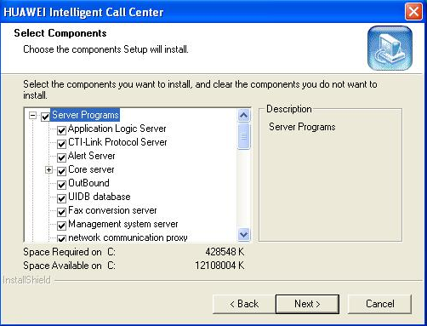
Installing CTI Platform in WINDOWS Contd.,
Step 7: Based on the type selection, the list of servers and client programs are displayed which will be installed. Additional components can be selected to install. Select Next

Slide 19
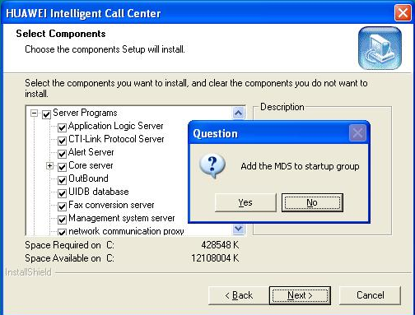
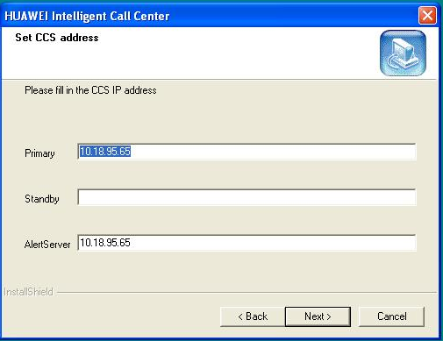
Installing CTI Platform in WINDOWS Contd.,
Step 8: Select Yes, MDS to run at Startup. Select No, to start manually
Step 9: Check the Primary CCS IP and Alert Server IP Address.
Select Next

Slide 20
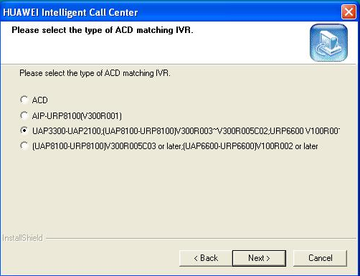
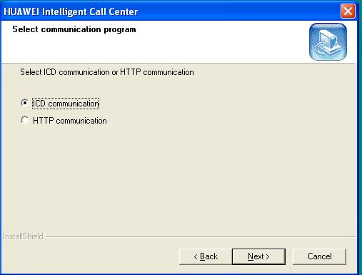
Installing CTI Platform in WINDOWS Contd.,
Step 10: Select the UAP type used for the setup. Select Next
Step 11: The components of the call center communicate with each other through the ICDComm. Thus, select ICD communication. Select Next

Slide 21
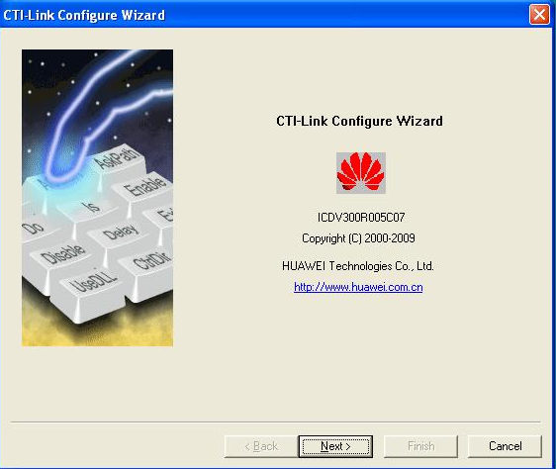
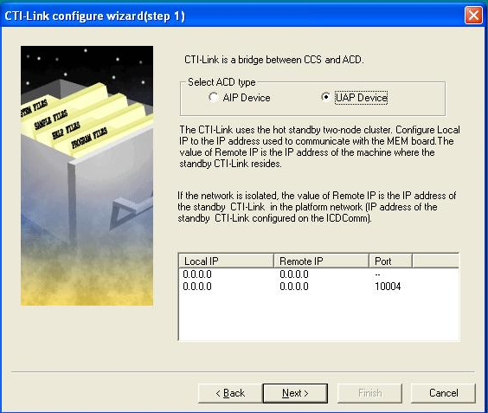
Installing CTI Platform in WINDOWS Contd.,
Step 12: CTI-Link Configuration
Select Next
Step 13: Select UAP device option and
Add the local IP. Select Next

Slide 22
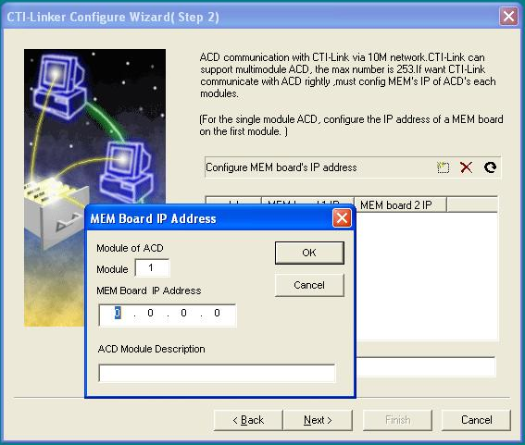
Installing CTI Platform in WINDOWS Contd.,
Step 14: Input UAP Module No and IP Address
Select OK and Select NEXT till the FINISH

Slide 23
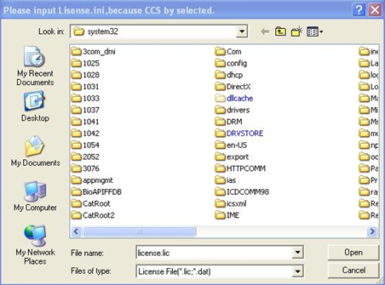
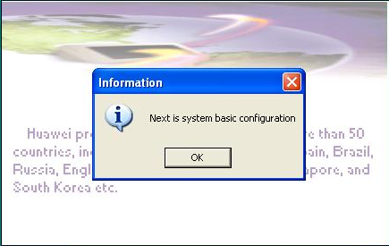
Installing CTI Platform in WINDOWS Contd.,
Step 15: CTI prompt for the License, Say Cancel to Proceed.
License can be uploaded later
Step 16: Select OK

Slide 24
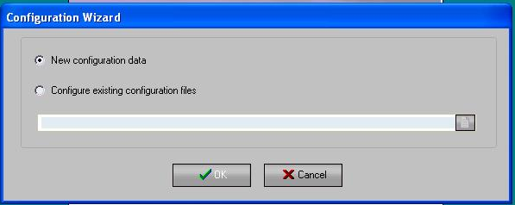
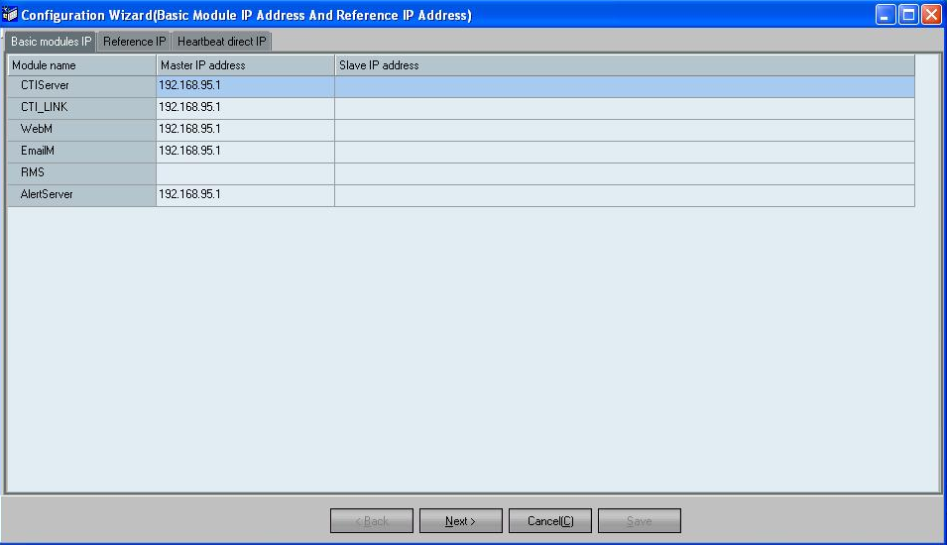
Installing CTI Platform in WINDOWS Contd.,
Step 17: Select OK
Step 18: Verify the details and Select Next

Slide 25
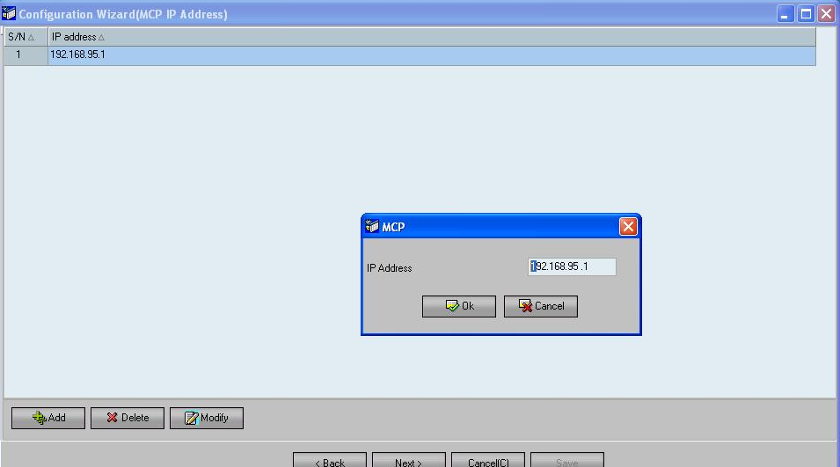
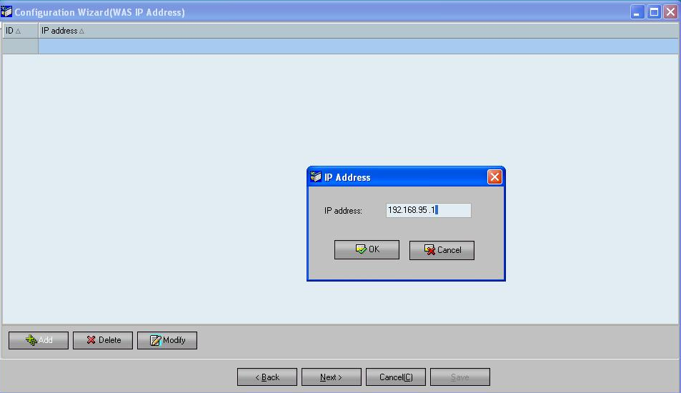
Installing CTI Platform in WINDOWS Contd.,
Step 19: Configure MCP IP Address
Step 20: Configure WAS IP Address
Notes:
MCP installs with the CTI, No need separate installation. By default WAS and CTI will be installed in single machine only

Slide 26
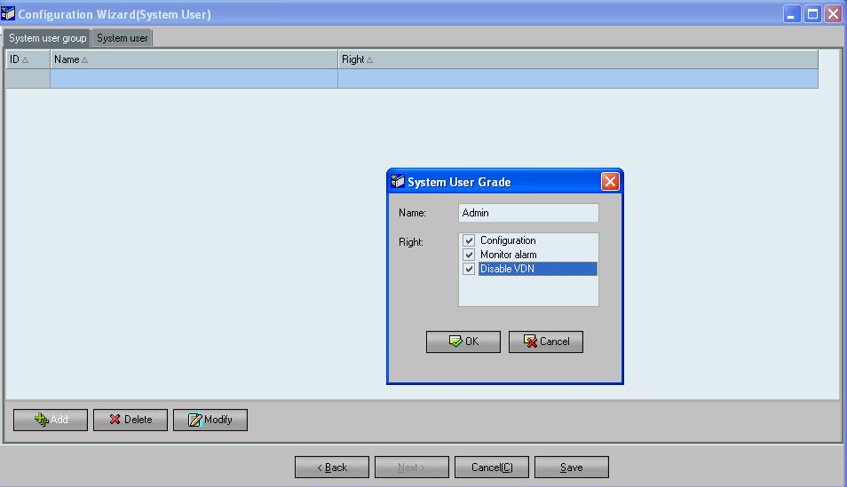
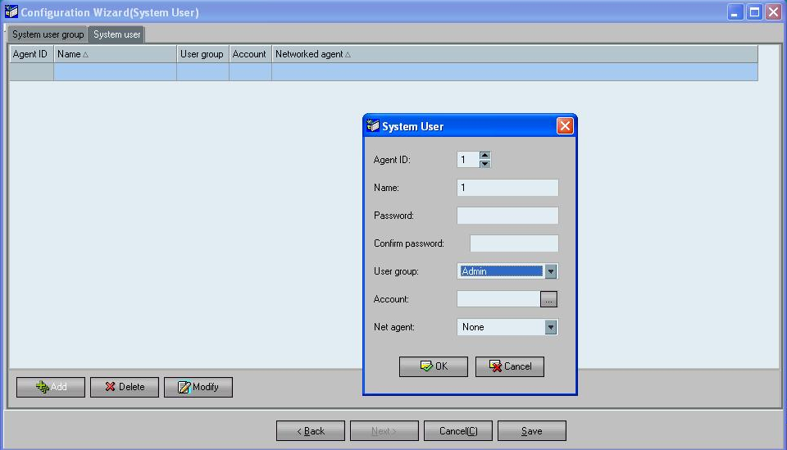
Installing CTI Platform in WINDOWS Contd.,
Step 21: Configure System User Group
Type Admin and Select OK
Step 22: Configure System User
Add Agent ID, associate to User group. Select OK
Notes:
System User Groups:
To facilitate the management of user permission, you can configure system user groups so that the system users in the same group have the same rights. The call center platform provides four types of rights. When adding a system user group, you can assign one or more types of rights from the four to the user group
Configuration :The agents who have this right can log in to the Web configuration console to perform system configuration.
Monitor Alarm :The agents who have this right can log in to the QC monitoring console to monitor the system and manage alarms.
Stop VDN: The agents who have this right can log in to the integrated configuration console to disable the use of the virtual call center.
Configuration Audit: The agents who have this right can perform configuration audit operations

Slide 27
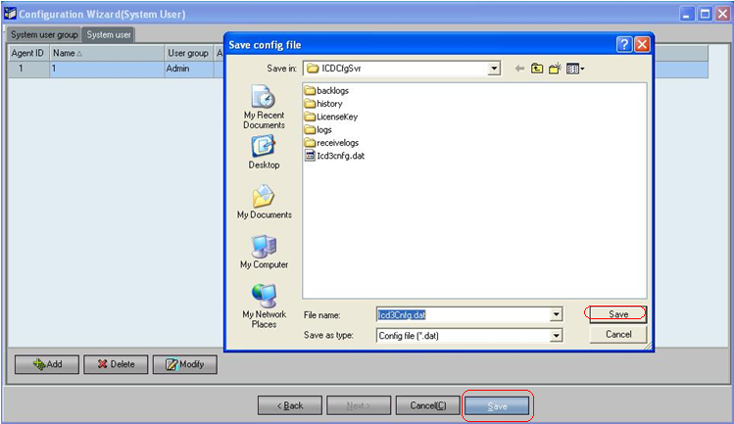
Installing CTI Platform in WINDOWS Contd.,
Step 23: Click On Save and save the configuration file ICD3Cnfg.dat in ICDCfgSvr directory.
NOTE: NetCheck Configuration, Email configuration & NIRC Configuration are not configured and hence their snapshots are not shown. select the Cancel option when these configuration prompts appear during the installation. These can configurations can be done later once the installation is complete, if required.

Slide 28
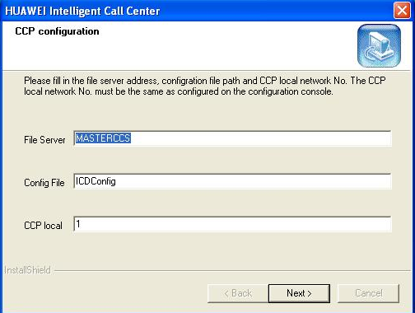
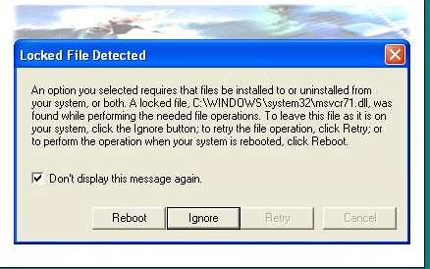
Installing CTI Platform in WINDOWS Contd.,
Step 24: Select Next
Step 25: Select check box and
Select Ignore to proceed

Slide 29
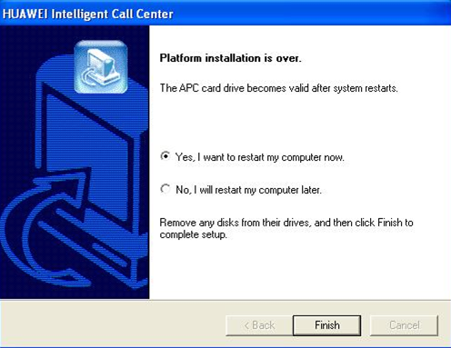
Installing CTI Platform in WINDOWS
Step 26: Select FINISH to complete installation and restart the computer.

Slide 30
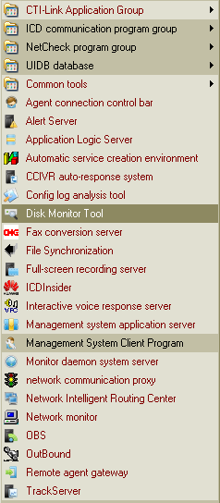
CTI Installed path in Windows PC
Once the CTI Installed is restarted, up and running.
Goto → Start → Programs → HUAWEI Intelligent Call Center
To see the CTI components that have installed in the system.

Slide 31
Agenda
Huawei IPCC Network Architecture Introduction
CTI Platform Overview and Installation
Web Application Server (WAS) Overview & Installation
CTI Upgradation
References

Slide 32
WAS Overview
WAS stands for Web Application Server
WAS is web based application for configuring the CTI system. It has the following modules.
Configuration console
VDN monitoring
System Monitoring
Quality Manager
Web Agent Module

Slide 33
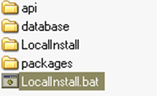
WAS Installation in WINDOWS
Path on support site:
Software Center => Version Software => Application and Software Product Line => Service and Software Public(19939) => CTI(360) => ICD(298) => ICD V300R005(163) => ICD V300R005C45(8)
File names:
ICDV300R005C45_WIN_ICD.zip
ICDV300R005C45_WAS_ICD.zip
ICDV300R005C45_PUBLIC_ICD.zip
Extract the “ICDV300R005C45_WAS_ICD.zip”, and run the Localinstall.bat to start installing.

Slide 34
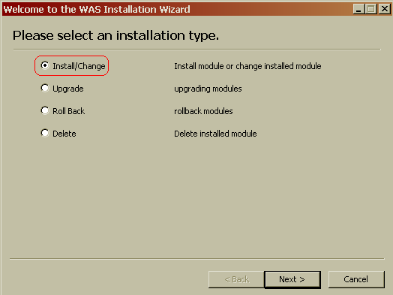
WAS Installation in WINDOWS Contd.,
Step 1: Select Install/change option and Select NEXT

Slide 35
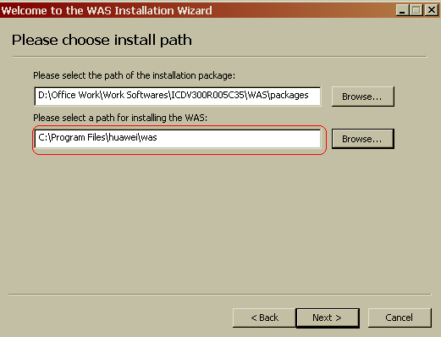
WAS Installation in WINDOWS Contd.,
Step 2: Browse the WAS installation path, Select NEXT

Slide 36
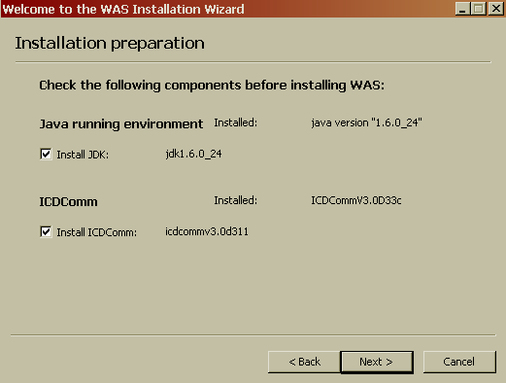
WAS Installation in WINDOWS Contd.,
Step 3:
1. Select the check box to install JDK and ICDComm. If previously not installed.
2. If already installed, Don’t Check
3. Select NEXT

Slide 37
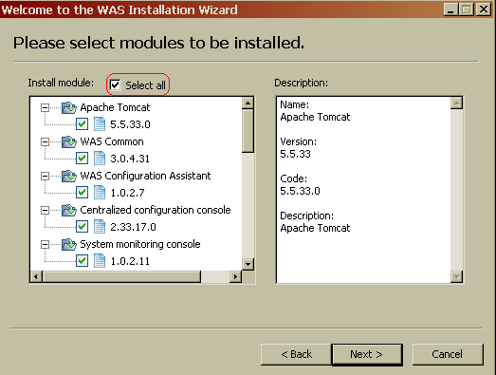
WAS Installation in WINDOWS Contd.,
Step 4: Check the Select all box and Say NEXT to install all the components

Slide 38
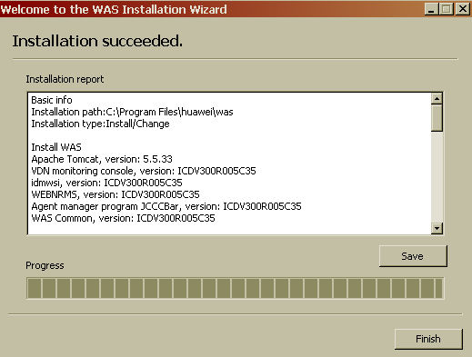
WAS Installation in WINDOWS
Step 5: Select Finish to complete the WAS installation

Slide 39

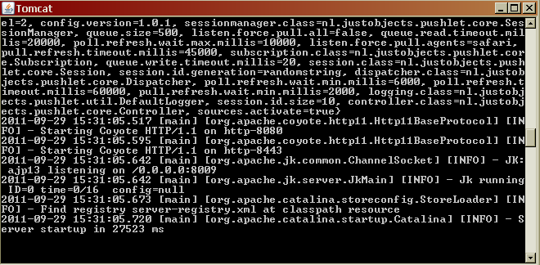
WAS Server StartUp
To Verify whether the WAS installation is successful.
Goto → Start → Programs → HUAWEI Web Application Server->Start WAS
TOMCAT Server for WAS is successfully started

Slide 40
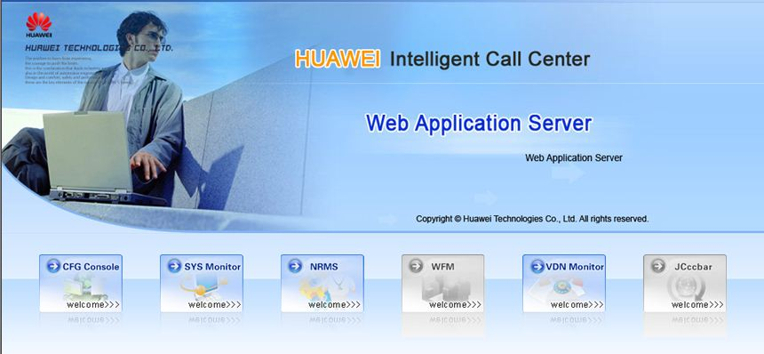
WAS Configuration Page
Goto → Start → Programs → HUAWEI Web Application Server-> WAS Homepage

Slide 41
Agenda
Huawei IPCC Network Architecture Introduction
CTI Platform Overview and Installation
Web Application Server (WAS) Overview & Installation
CTI Upgradation
References

Slide 42
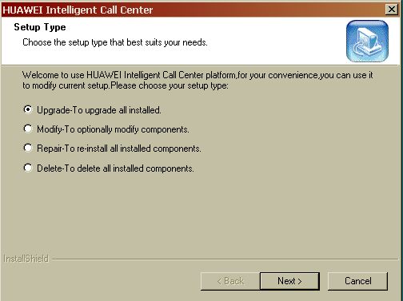
CTI Platform Upgradation
Steps to be followed to upgrade the CTI version are as follows:
1. Run Setup.exe of the latest CTI version, the below prompt appears Using this the CTI can be upgraded, can modify the CTI components, Repair the existing version and can uninstall the CTI.
2. Say Next
3. Goto Slide 10, Continue from Step 4 for further installation.

Slide 43
Agenda
Huawei IPCC Network Architecture Introduction
CTI Platform Overview and Installation
Web Application Server (WAS) Overview & Installation
CTI Upgradation
References

Slide 44
References
CTI Installation References:
For CTI Installation on Linux OS, HP-UX & IBM-AIX
For CTI Database installation and configuration
Refer: HUAWEI Call Center Installation Guide(V300R005C30_01).pdf
WAS Installation References:
For installation of WAS in Linux OS and Windows OS
Refer: HUAWEI Call Center WAS Installation Guide(V300R005C45_01).pdf

